Slide 1
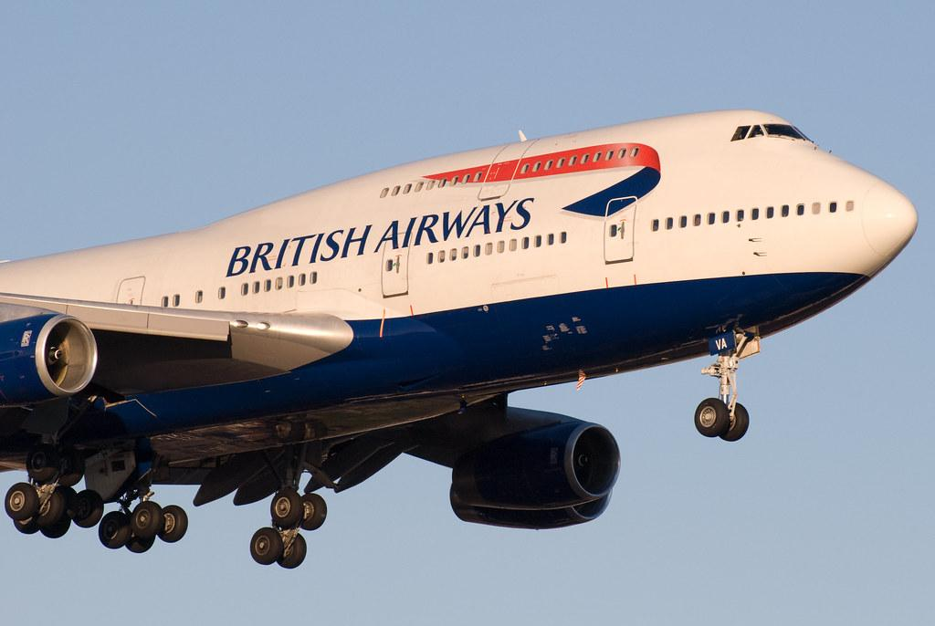
Analysis of Reviews for British Airways
Dataset used - Skytrax

Slide 2
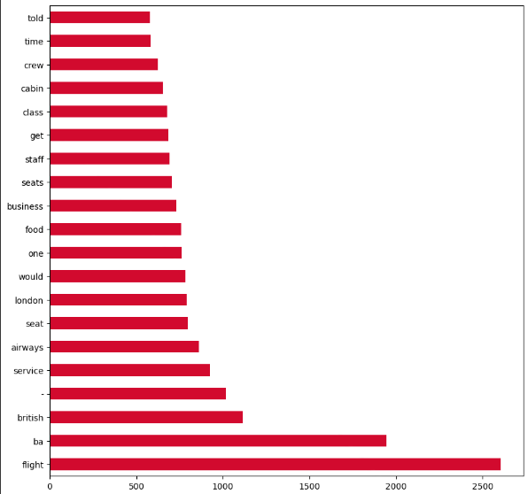
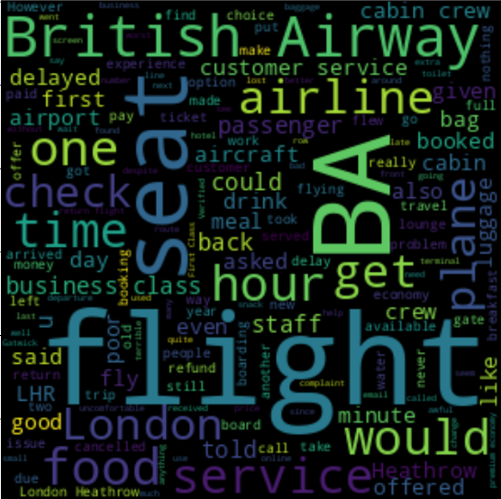
Analysis of Reviews for British Airways
Out of total 3900 reviews
57.6% positive reviews
42% negative
reviews
0.3% neutral
reviews
Word Cloud of negative reviews
Bar Graph of Top 20 most frequent words of negative reviews
These visualisations indicate that there are problems such as flight delay , quality of food is not good, quality of services being offered by crew is not up to mark , refund of money process is not good, seat or cabin problem as they cannot be comfortable to passengers , Customer service is not good.

